Slide 1

DUNE COMPUTING OVERVIEW Heidi Schellman FOR THE COMPUTING CONSORTIUM

Slide 2
This talk
Overview of DUNE computing
Organization big picture
Hardware resource model

Slide 3
Computing Consortium
Compute Facilities
Core Software
Algorithms/Shifts
Hardware
Computing Experts
Collaboration
National infrastructure
Framework
Algorithm development
Core Infrastructure
WLCG/OSG
Operations shifters
R+D
HPC
Code Integration
Validation
Networking
Coding standards
Computing Contributions Board
Training

Slide 4
Governance
Consortium Board
Computing Contributions Board
Computing Resource Allocation Board
Institutions doing Core Development
Large hardware contributors
Nations
Physics Conveners
Reco/Sim Convenors
Computing Operations
Core Software

Slide 5
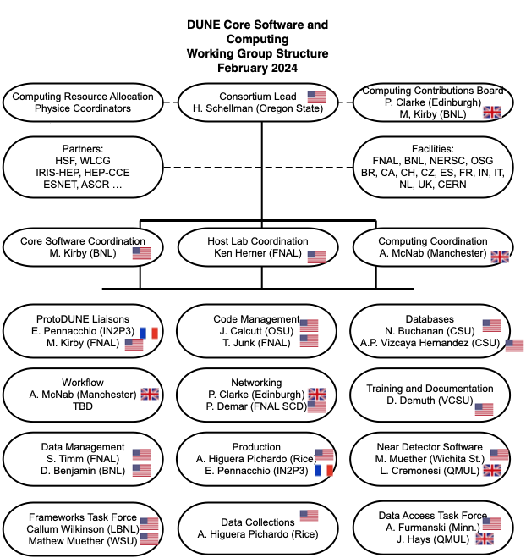
Org chart

Slide 6
Charge questions
Provide feedback on the comments from the previous NSG meeting, specifically:
Several of the recommendations of the July 2023 Software and Computing review are expected to be closed by Fall 2023 or early 2024. The NSG is interested in the responses presented at the next NSG meeting.
How well defined are the interfaces between the scope of the computing consortium and those of other groups within the collaboration, particularly the DAQ consortium, the various detector consortia, and the analysis groups working on algorithms?
Please comment on the preliminary schedule for DUNE computing. Is it appropriately connected to the schedule for DUNE physics? Are major milestones defined?
How complete is the understanding of current and future computing needs? This question applies to hardware, software, personnel, and leadership.
Are there gaps between the current and future computing needs and the resources available?
Are the current and planned contributions to DUNE computing from institutions within the collaboration appropriately sized and distributed? Please consider the balance between US and non-US, between university and lab, and between Fermilab and non-Fermilab contributions to hardware, software, personnel, and leadership.

Slide 8
Basics of the resource model
Keep raw data on disk for 1 year, on tape to end of expt.
For protoDUNE – 1 copy each at CERN/FNAL
For DUNE 1 copy at FNAL, 1 copy at other institutions
Reconstruct full sample every year (protoDUNE for 4 years, DUNE to end of expt.)
Do new simulation campaigns each year
Keep simulation and reconstructed data on disk for 2 years (always have 2 versions)
One copy in Americas, one in Europe where possible (model assumes 1.5 copies)
No need to stage from tape until it ages out
One copy of reconstruction/simulation -> tape as it can be redone if necessary.
CPU estimates are based on measurements from ProtoDUNE data and existing simulations
ND estimates have large uncertainties.

Slide 9
Updates to the model
Delayed ProtoDUNE II operations until Spring 2024
With the successful large-scale FD simulation campaigns, we have considerably better understanding of both our processing time expectations and our simulation needs
not all of that additional information has been included in the model just yet (minor tweaks)
new estimates for FD processing time based upon multithreaded processing and subsequent smaller memory footprint
updated files sizes for reconstruction and simulation output – no longer estimate based upon retention of the raw waveforms in data or all rawdigits in the simulation
still working on understanding the GPU requirements for 2x2 and ND-LAr and how those estimates can be translated
We are transitioning from MWC to HEPScore23 (HS23) as the metric for CPU resources

Slide 10
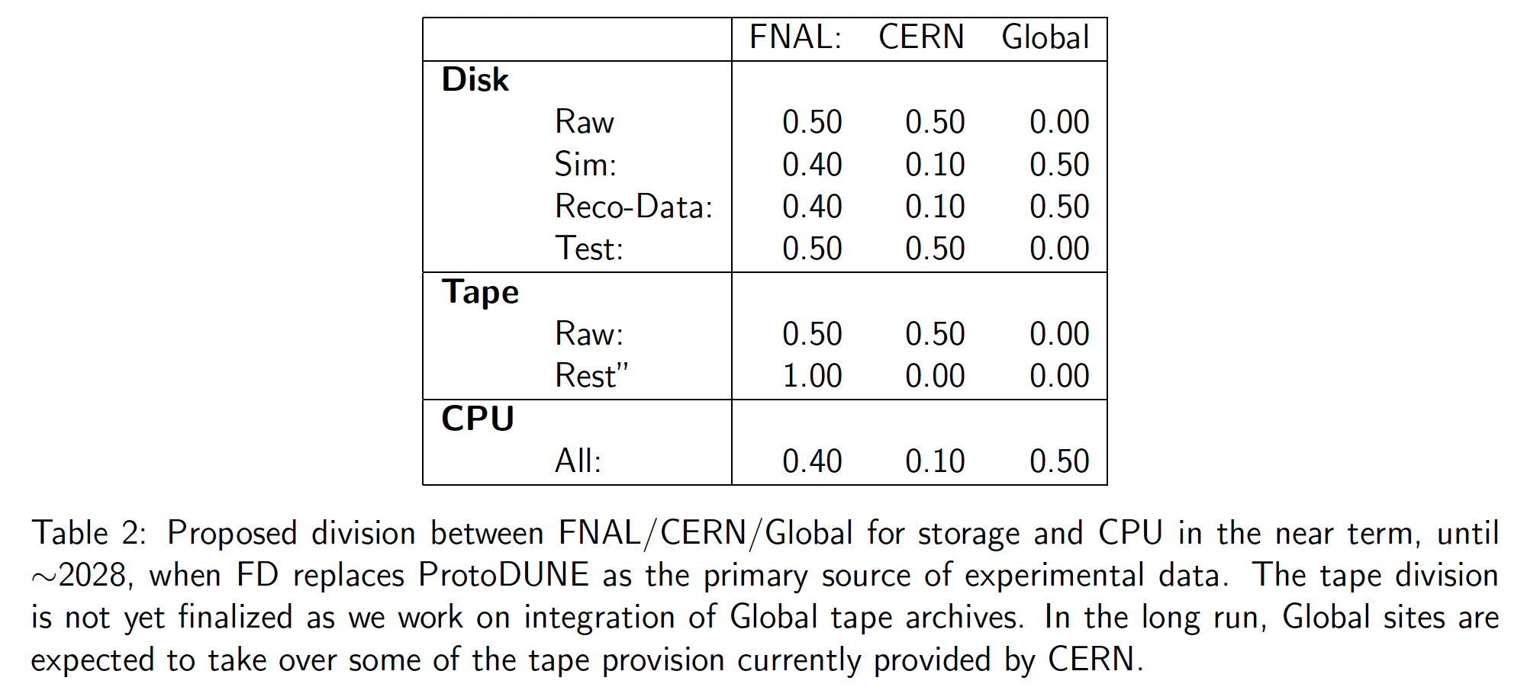
Proposed divisions between nations/labs
Global here means non-CERN, non-FNAL.
Includes other US national labs

Slide 11
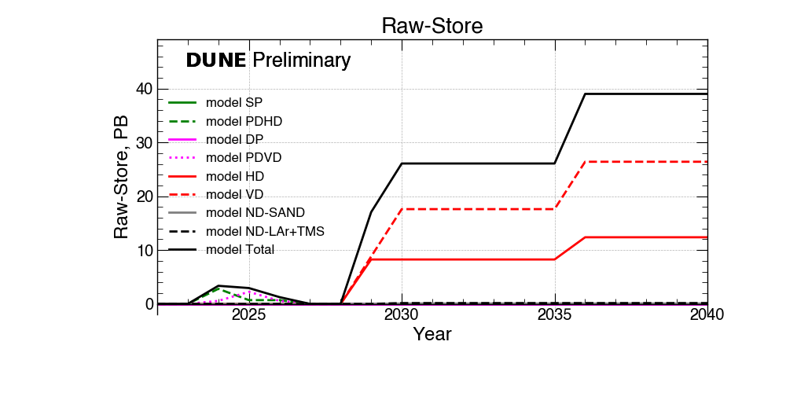
The longer term
We are still doing R+D on Near Detector Computing and optimizing Far Detector codes. Need data from 2x2 tests!
As a result, CPU estimates are difficult
But storage is largely driven by raw data. This shows estimated raw data per year
Cumulative needs on the next slide.
Data Taken Per Year

Slide 12
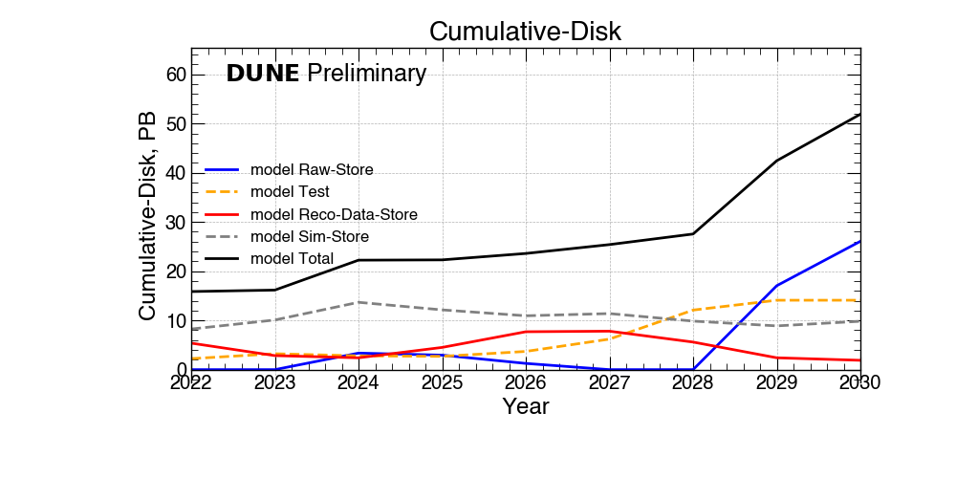
Projected Disk Needs 2022-2030 Needs

Slide 13
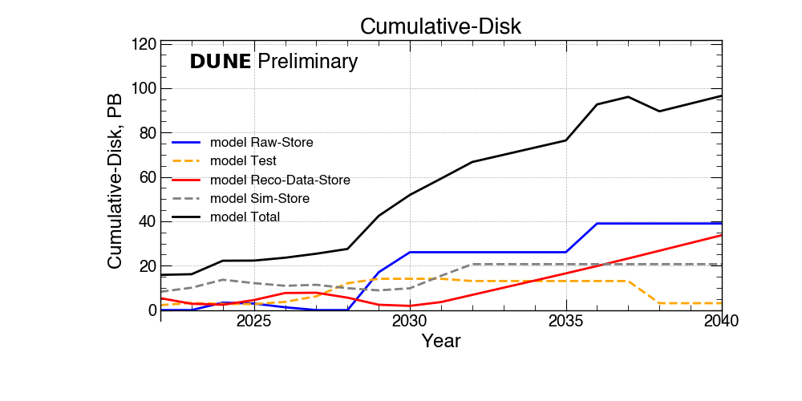
Projected disk needs 2022-2040

Slide 14
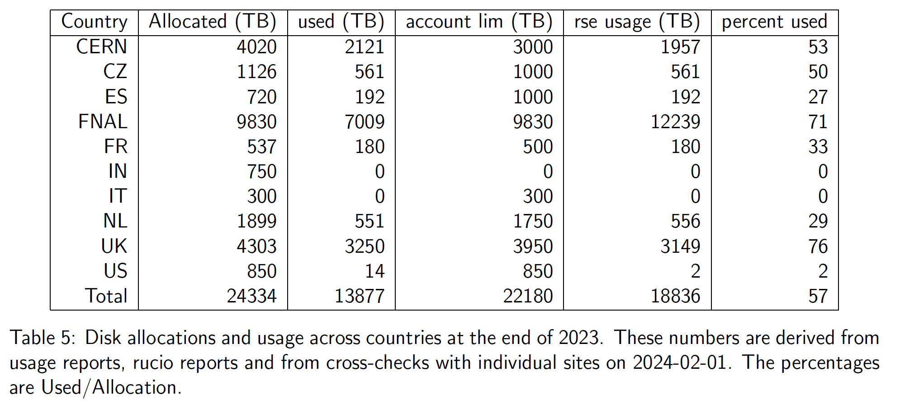
Summary of allocation/use as of February 1, 2024

Slide 15
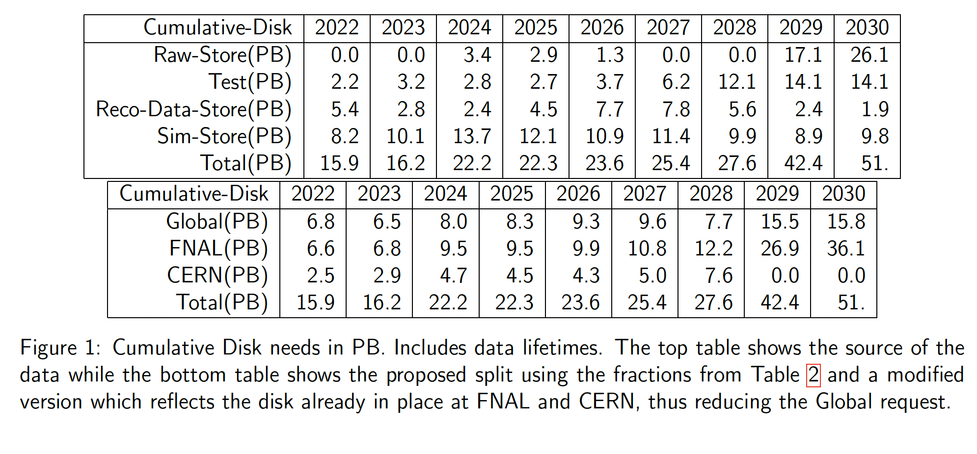
Disk requests from the model

Slide 16
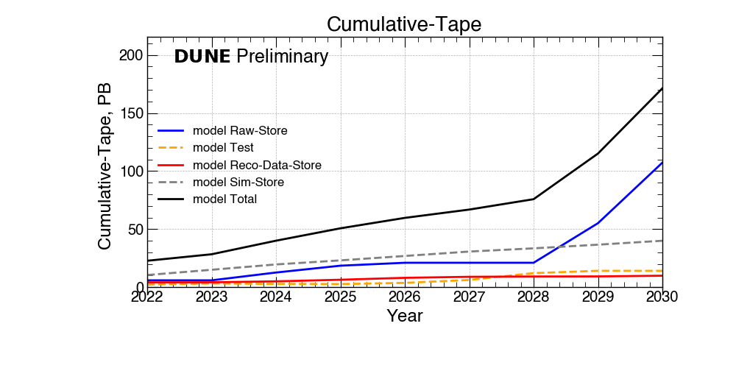

Projected Tape Needs 2022-2030

Slide 17
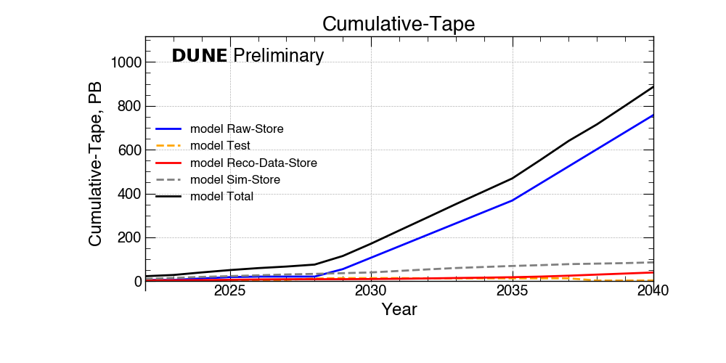
Projected Tape Needs 2022-2040

Slide 18
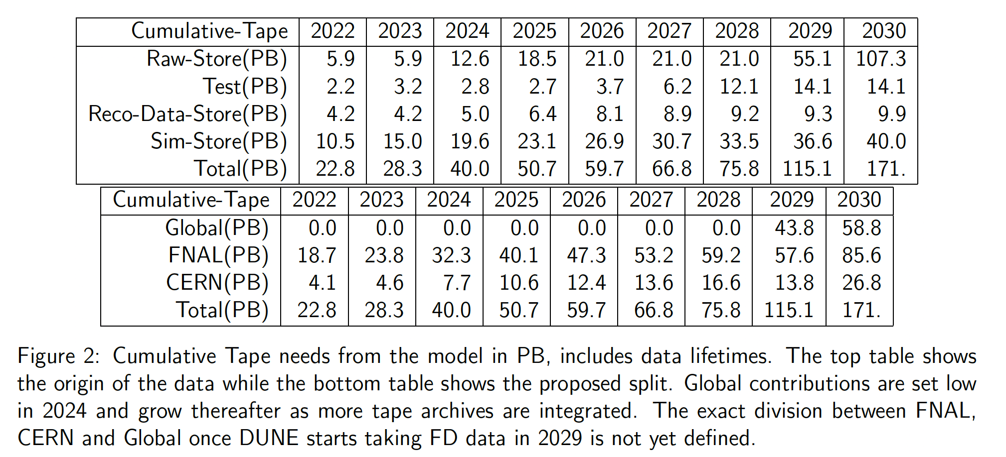
Numbers for tape needs

Slide 19
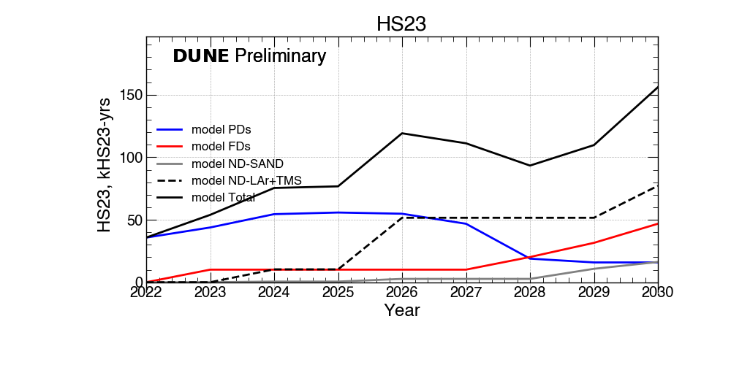
Projected CPU needs 2022-2030

Slide 20
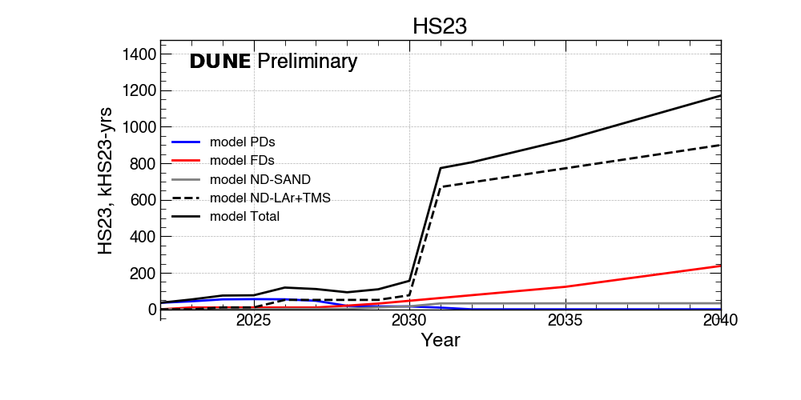
Projected CPU needs 2022-2040
CPU estimate driven by simulation needs for ND

Slide 21
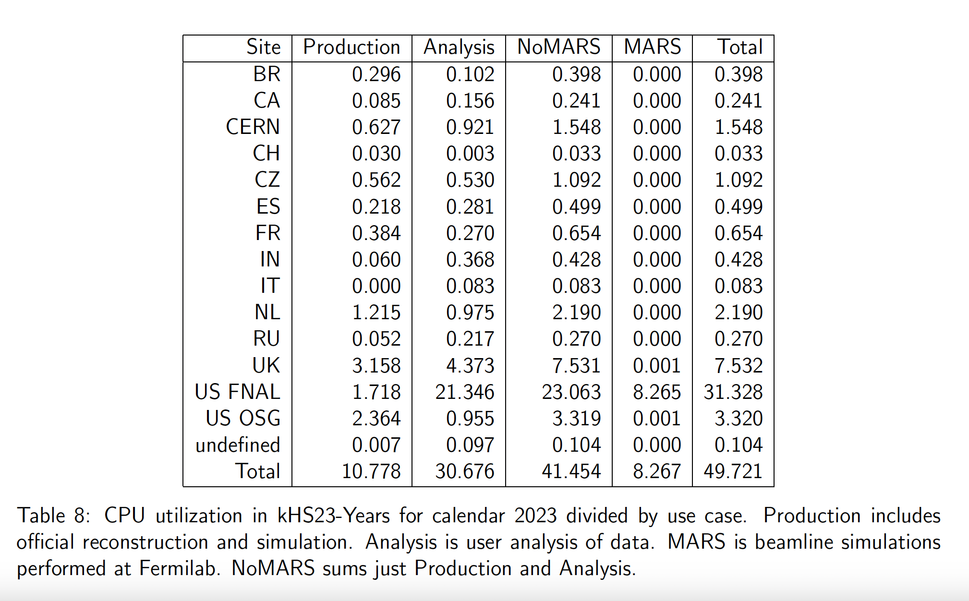
Actual CPU usage in 2023

Slide 22
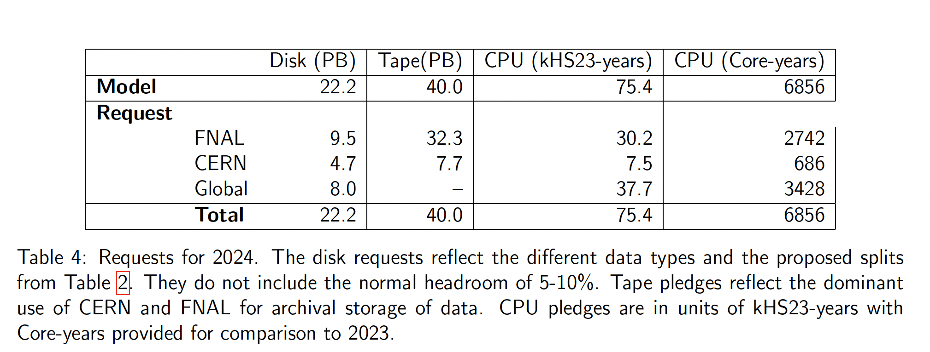
Summary of resource request for 2024
Disk request includes existing FNAL and CERN contributions

Slide 23
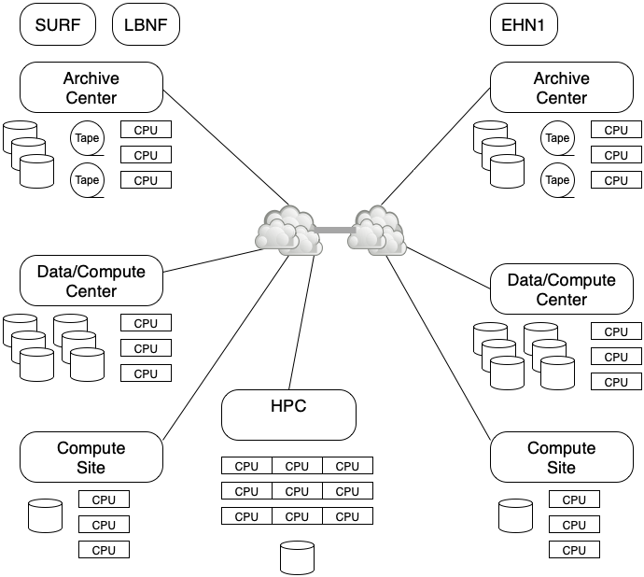
DUNE computing model
Less hierarchical than original WLCG model
Able to use opportunistic resources
Sites offer services
Archival (few)
Disk (Rucio Storage Element)
CPU
HPC

Slide 24
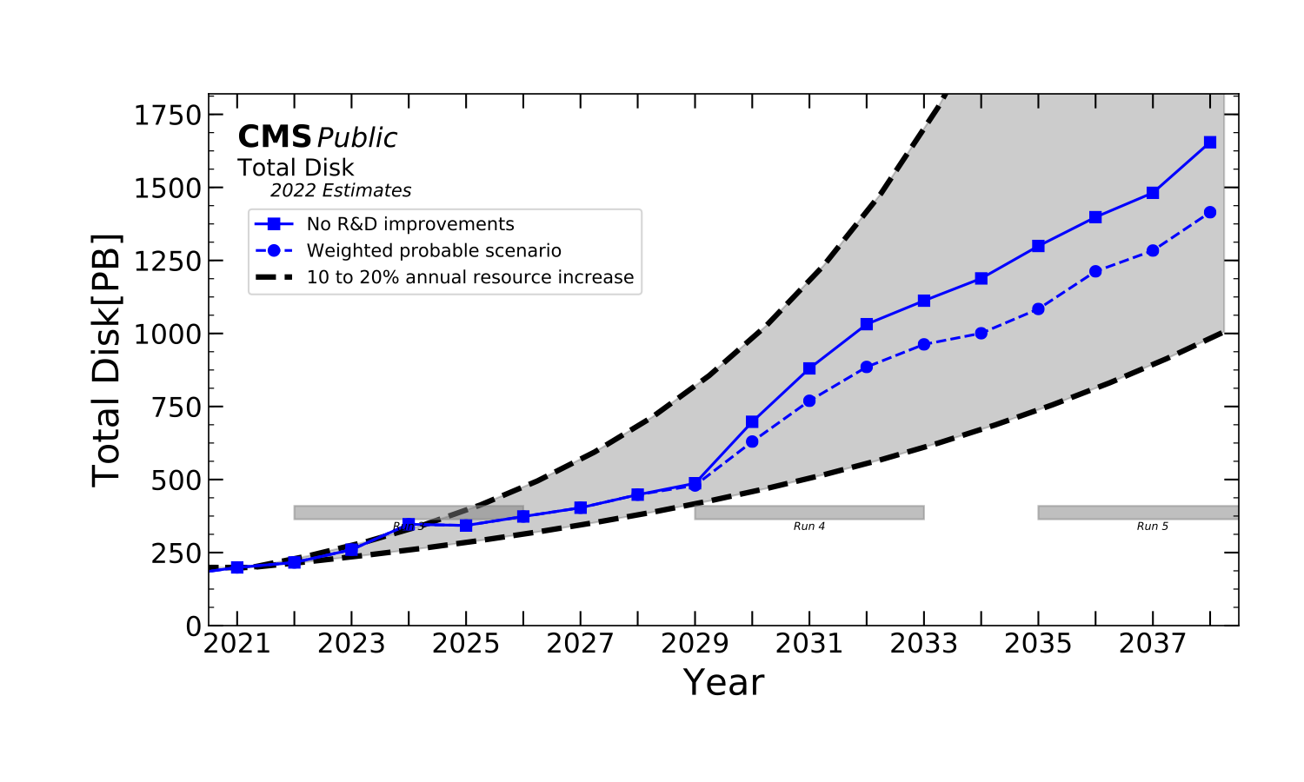
Disk compared to CMS
Disk ~ 5-10% of an LHC expt.

Slide 25
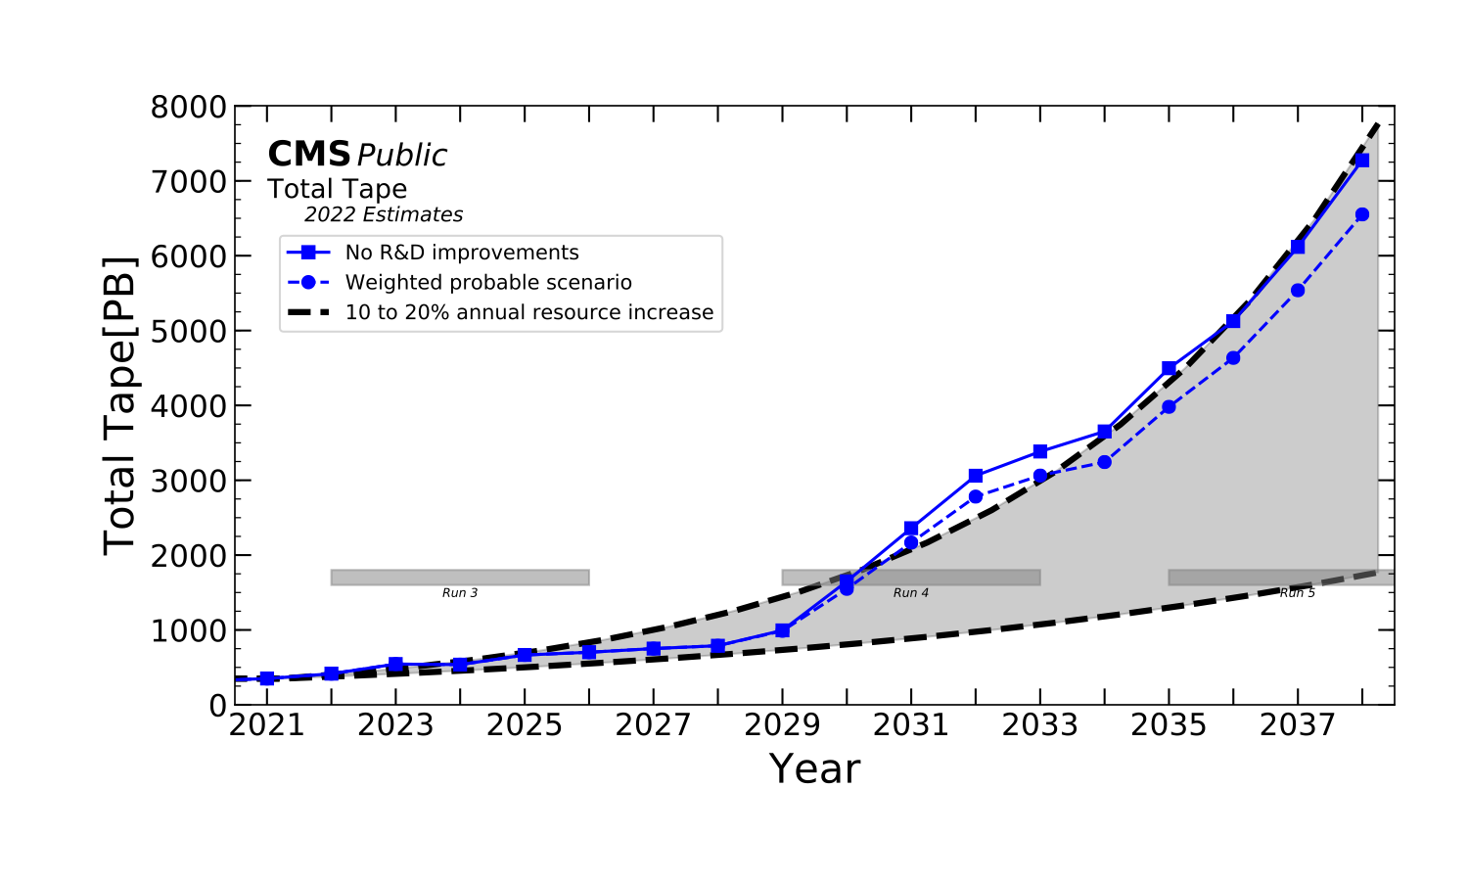
Tape prediction
Tape 10-15% of an LHC experiment

Slide 26
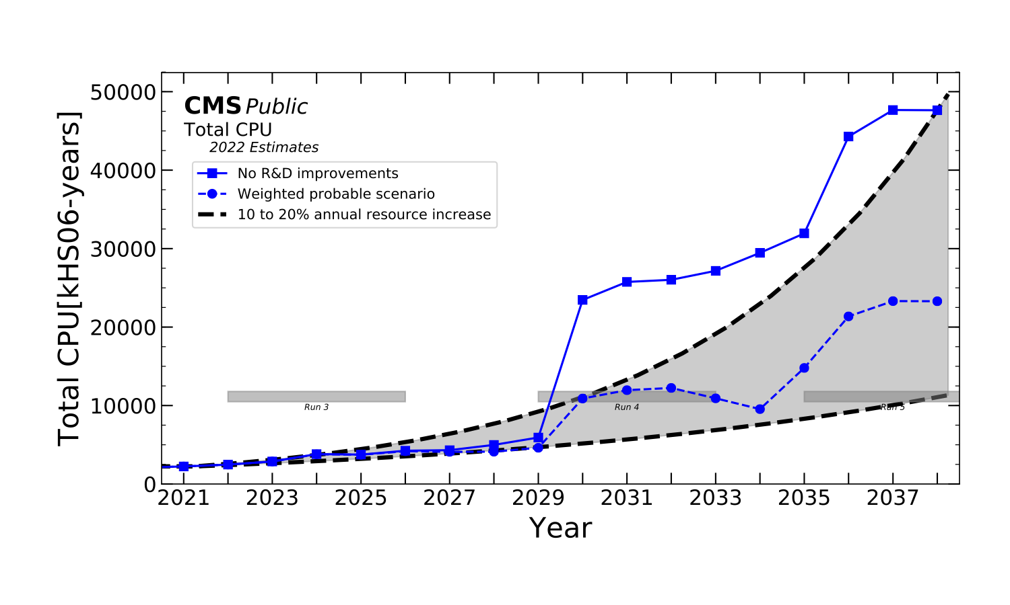
CPU/GPU
CPU is much harder to estimate as depends on human behavior
CPU ~ 10% ???

Slide 27
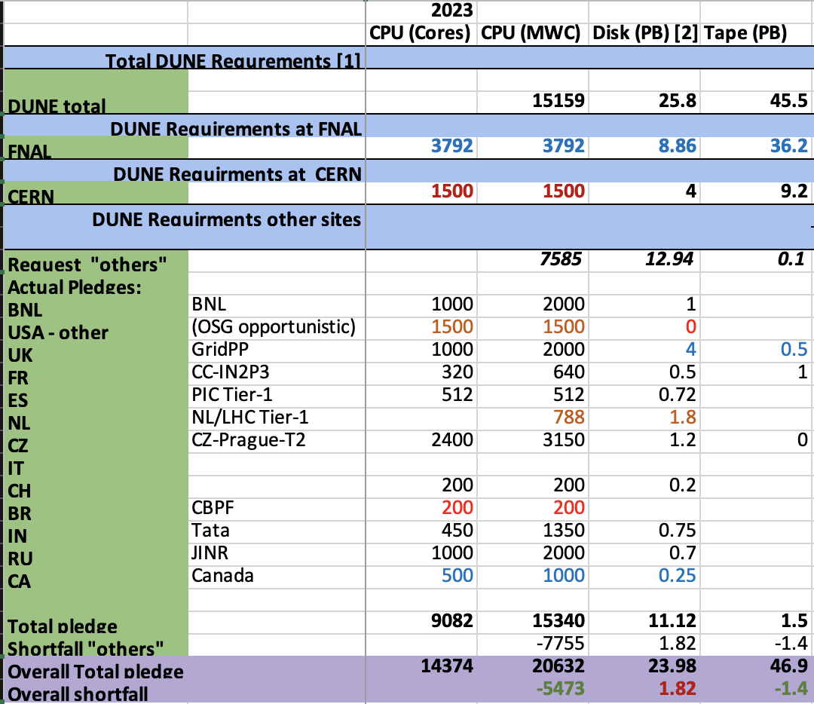
Global contributions
REQUEST
Computing Contributions Board
Chaired by Pete Clarke
Voluntary pledges of CPU and disk
This is 2023- 2024 still in progress

